Slide 1

GEO3460 – Geografiske informasjonssystemer (GIS) og geografisk datainnsamling – vår 2025
GEO3460 - Geographical Information Systems (GIS) and Geographical Data Acquisition - spring 2025
Geographic Coordinate Systems
and the nightmares of
Pedantic Geodesy
Luc Girod (luc.girod@geo.uio.no)

Slide 2
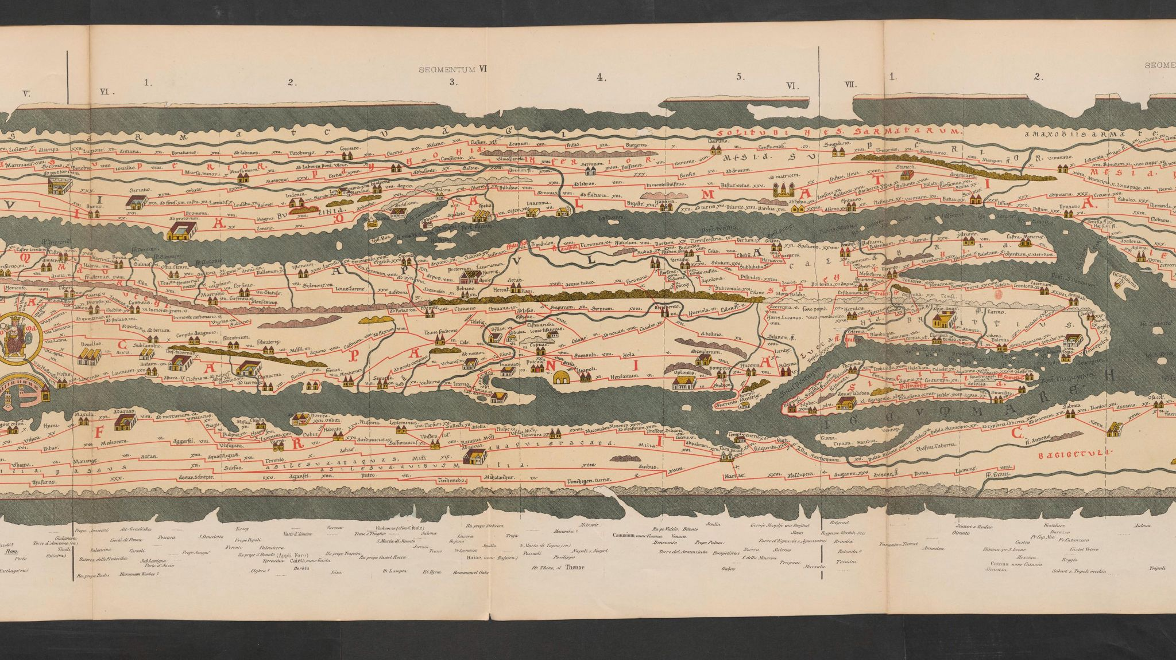
Maps don’t always strive to represent the land geometry

Slide 3
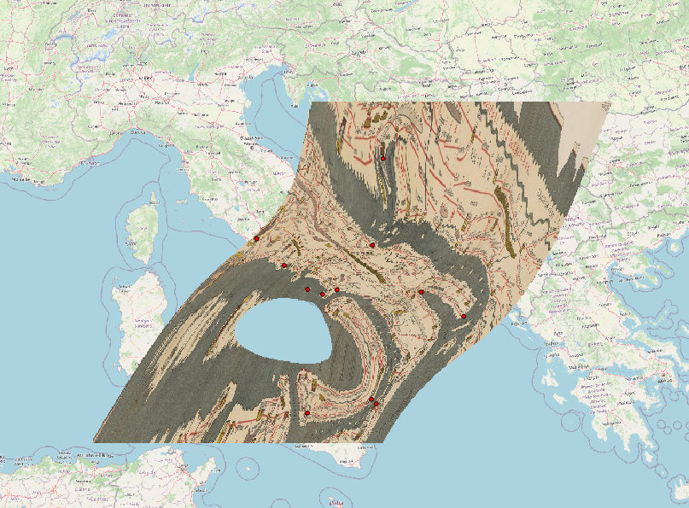

Slide 4
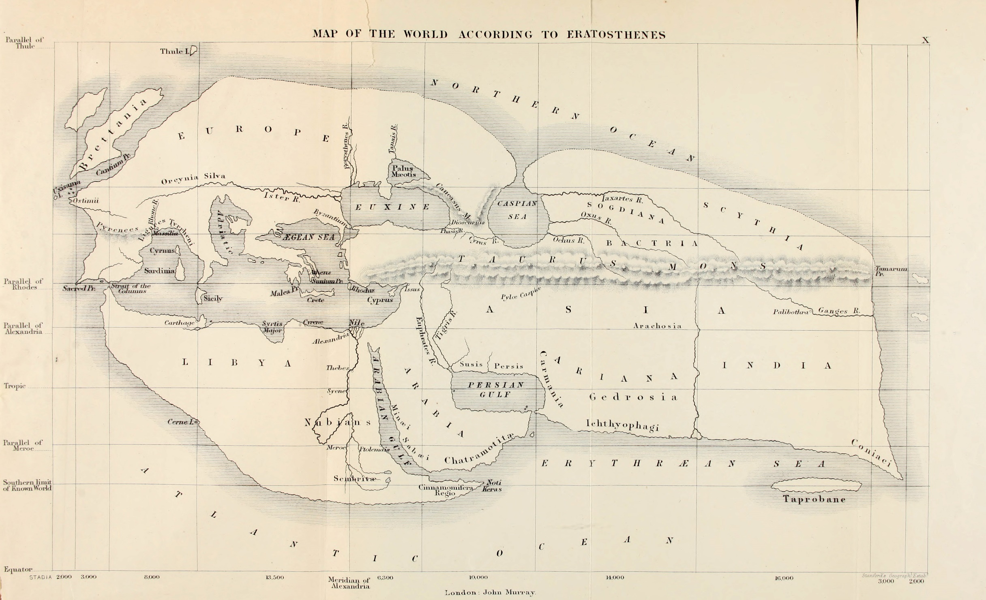
But they try
19th century reconstruction of Eratosthenes' map of the known world, c. 194 BC.

Slide 5
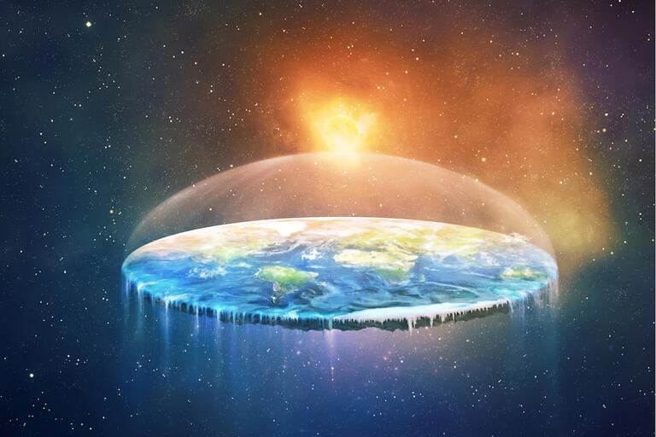
Trying to make a map makes you quickly realize that the Earth is spherical…(or close to)

Slide 6
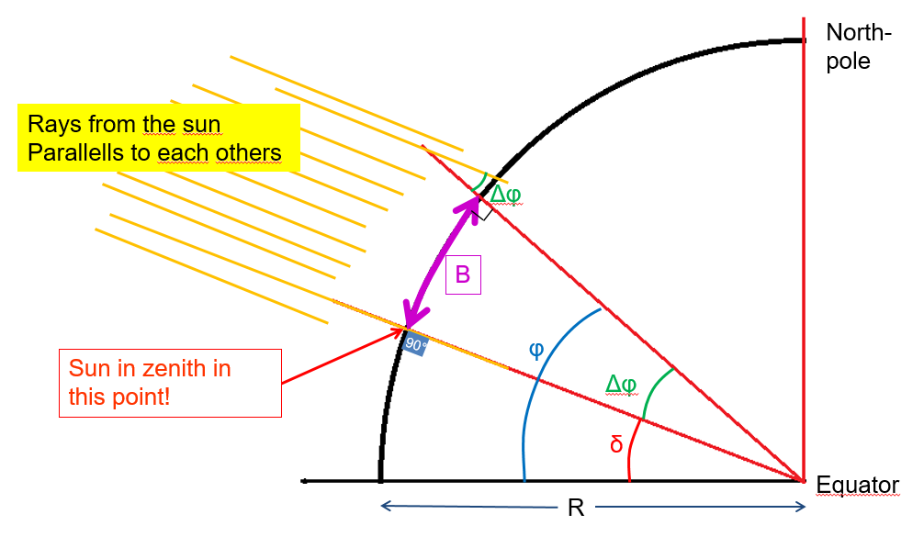
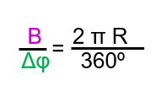
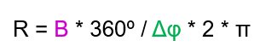
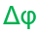
…and that you need to know its size
If you can measure B and accuratelly enough, you can figure out the size of Earth

Slide 7
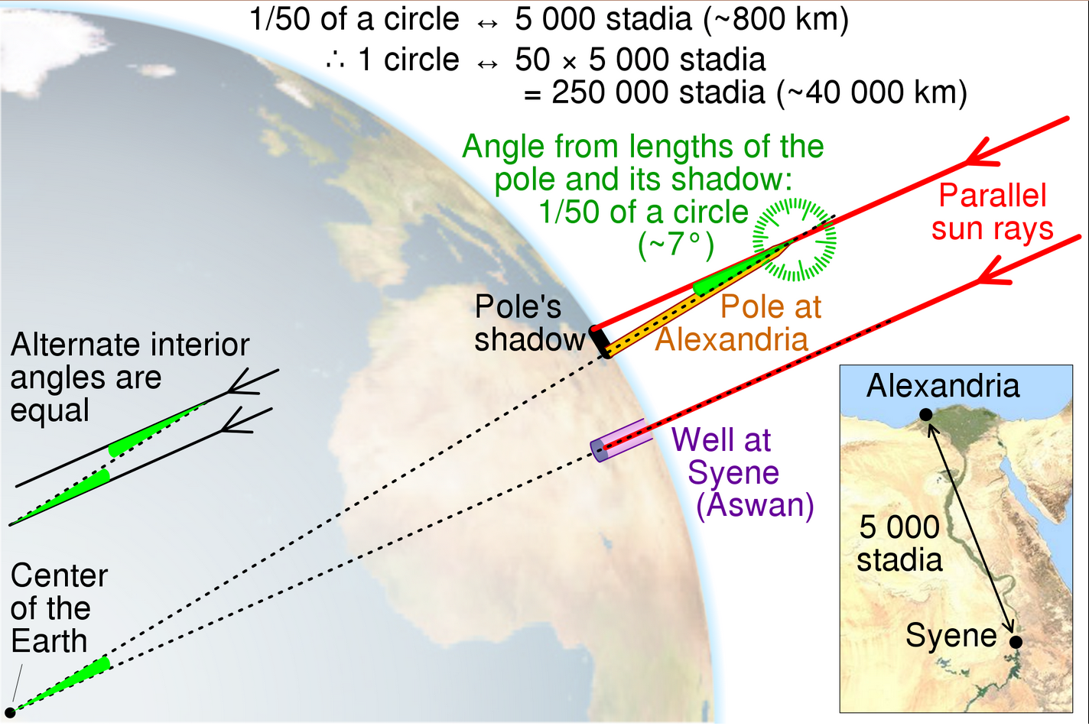
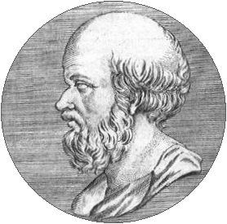
Eratosthene’s attempt
The meridian has a length of 252,000 stadia, with an error on the real value between −2.4% and +0.8% (assuming a value for the stadion between 155 and 160 metres).
https://en.wikipedia.org/wiki/Earth%27s_circumference#/media/File:Eratosthenes_measure_of_Earth_circumference.svg

Slide 8
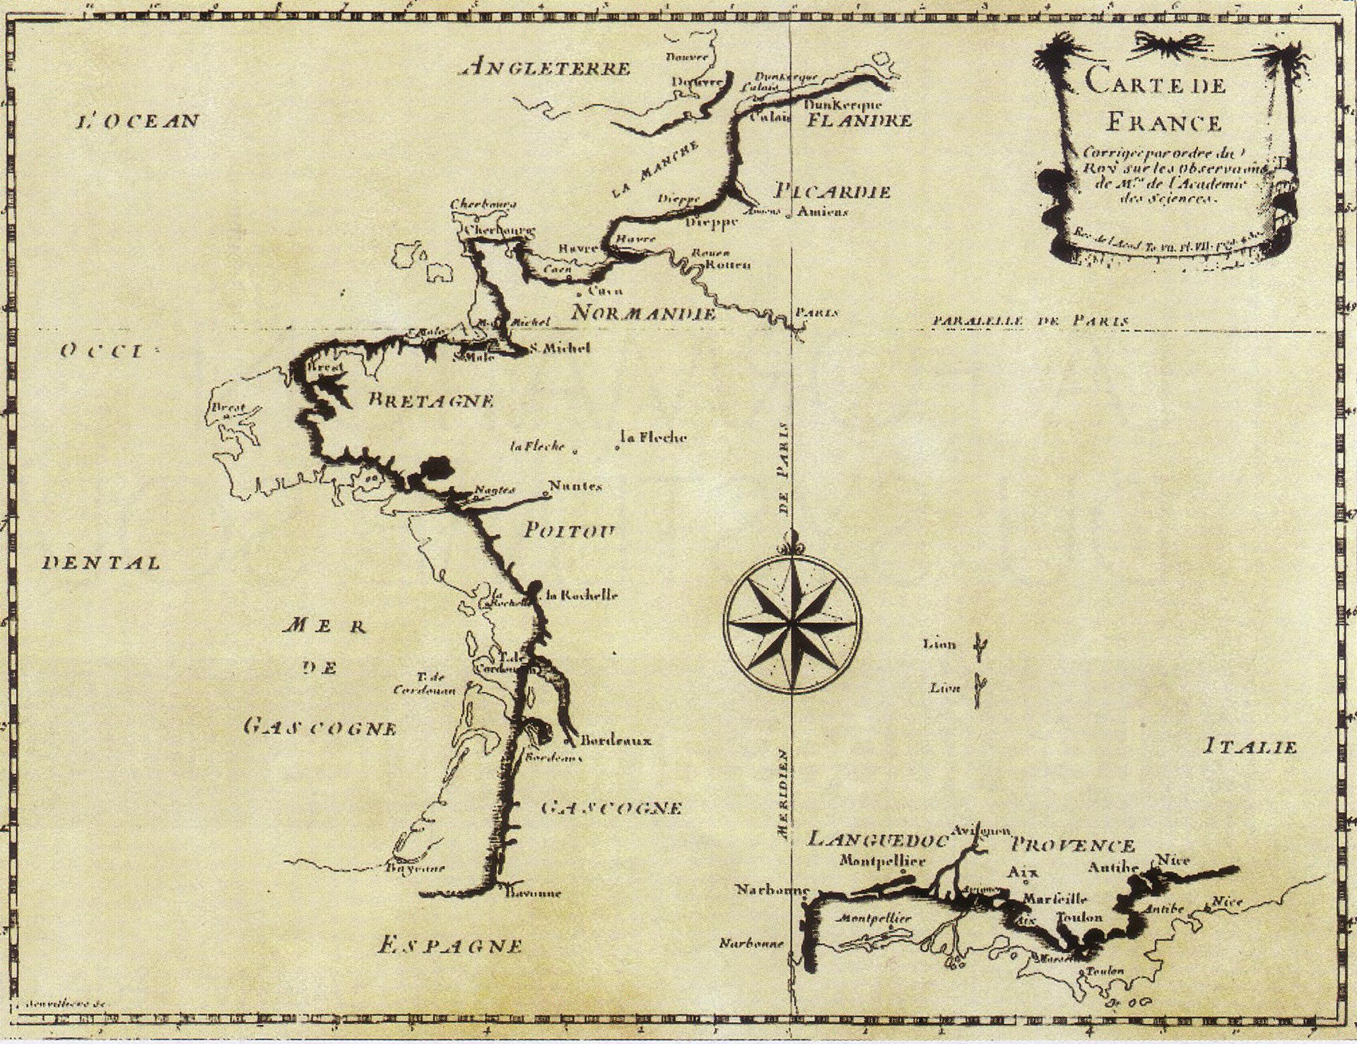
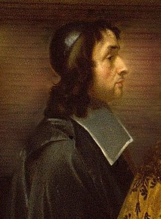
Size of the Earth
Geometrically accurate maps become a concern in the 1600s
The Abbé Jean Picard measured a meridian arc from Paris to Amiens to be 1° 22′ 55″, and 57,060 toises, giving 6,538,594 toises for the Earth's diameter
1 toise = 1.94903631 m
Diameter = 12 743 957 m
Radius = 6371978,56 m

Slide 9
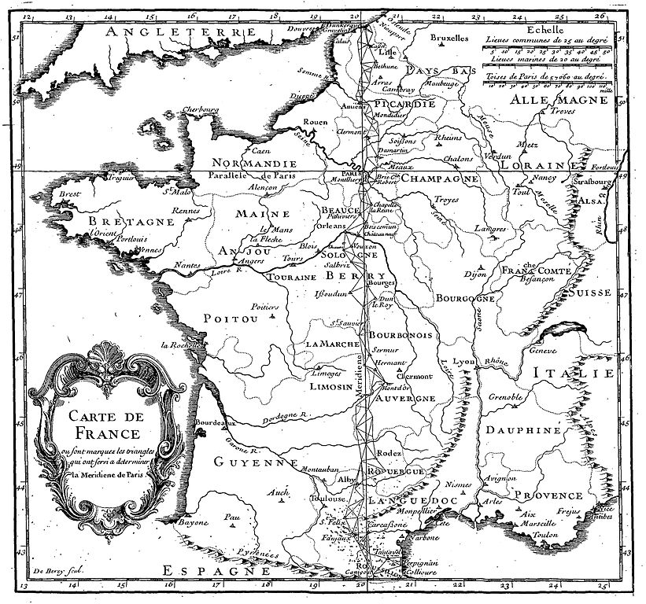
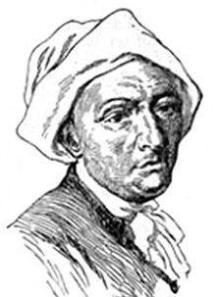
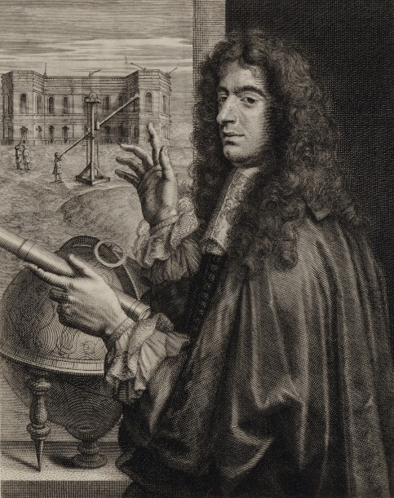
Shape of the Earth
Picard’s measurments assumed a spherical Earth,
Oddities in clock calibration hinted at non-stable gravity at sea level.
New measurments by Cassini and La Hire in Northern and Southern France gave different measurments.
North: 56,960 toises per degree
South: 57,097 toises per degree
A degree is longer further south?
Map of France in 1720 with the Paris meridian from Dunkirk to Perpignan

Slide 10
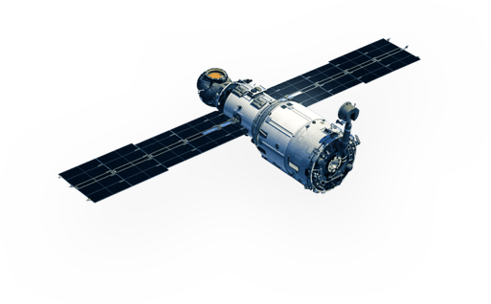
POSITION: Latitude and Longitude?
Position
– Latitude - from «astronomic» observations
→ Suns max elevation (angle to the sun) in a day
→ Compare to date to find latitude
At night, the polar star is relativelly fixed,
or more complex calculations can be done with stars/distant galaxies/quasars
Longitude: Sun straight south = Local Noon 12:00
→Difference with a reference clock gives the longitude

Slide 11
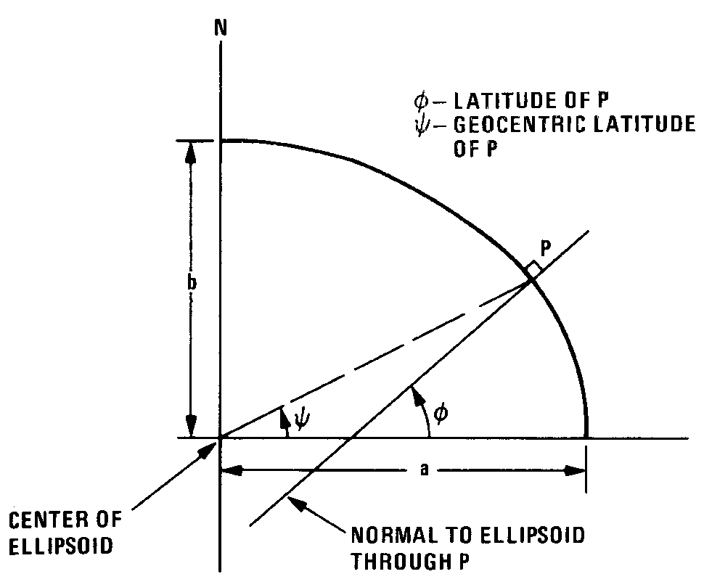
If the Earth isn’t a perfect sphere, then the latitude as measured from the surface isn’t the angle at the Earth’s center, but at the intersection of the normal to the surface (actually, the Ellipsoid) and the equatorial plane.

Slide 12
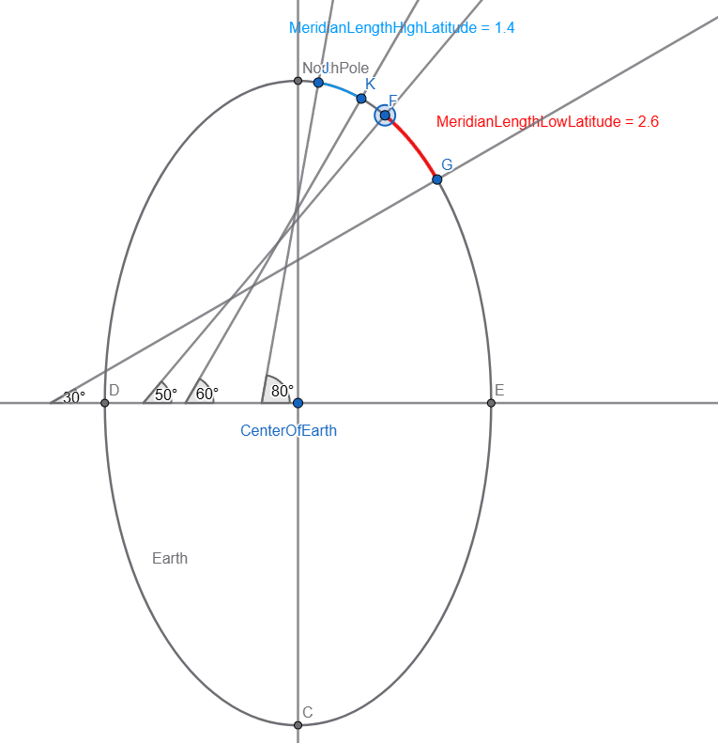
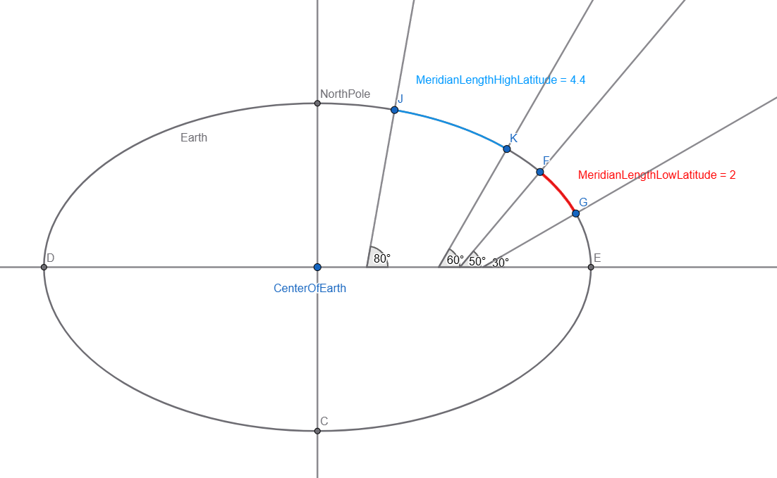
Cassini and La Hire
Egg or Peach?

Slide 13
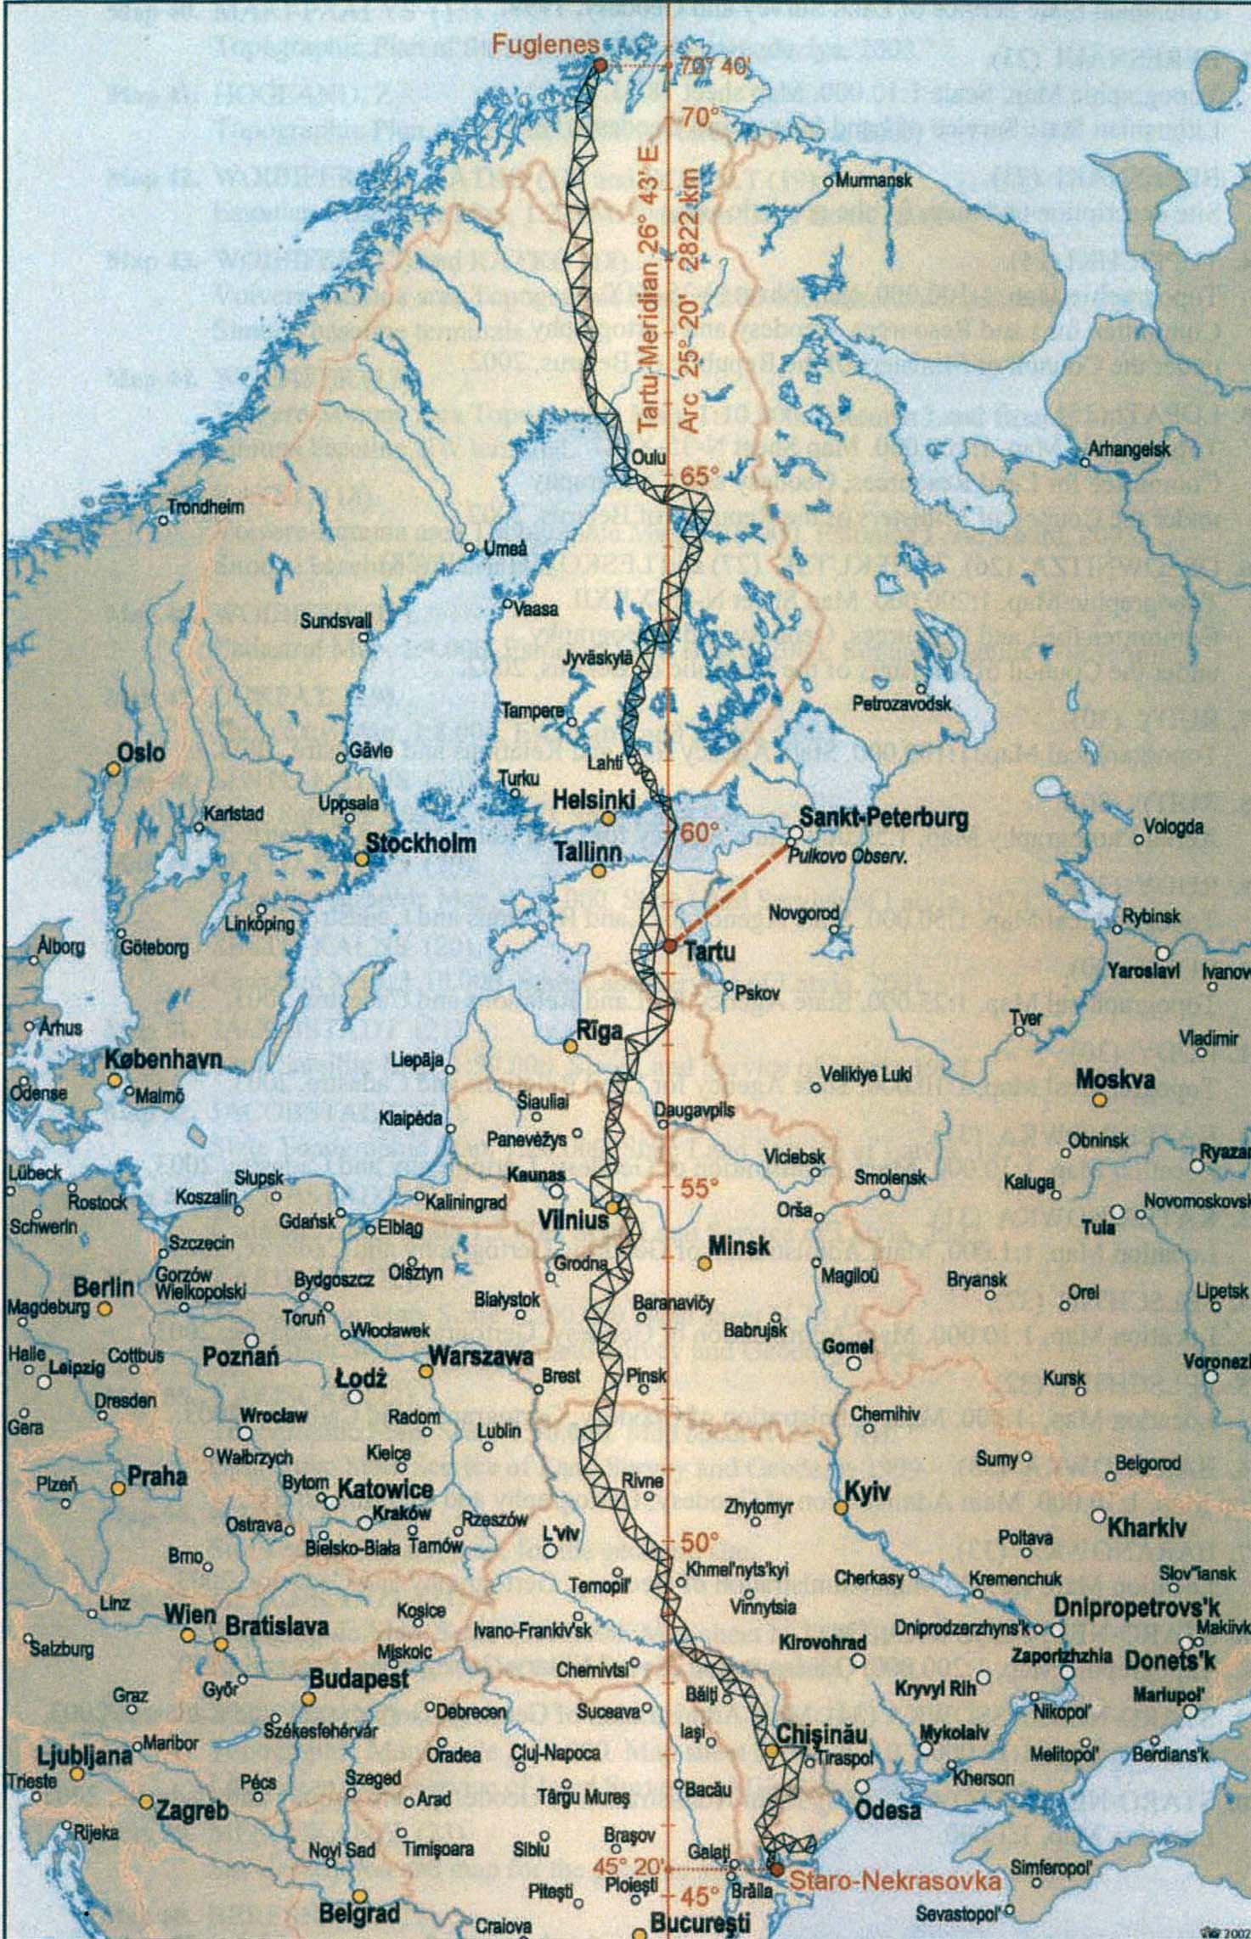

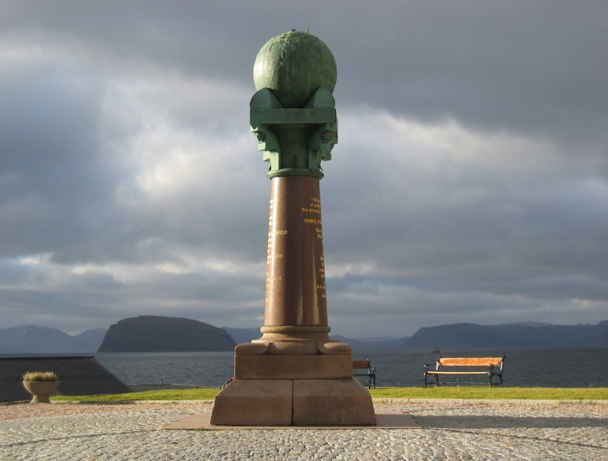
Size of the Earth
(meridian arc)
Struves meridian arc
1816-1855

Slide 14
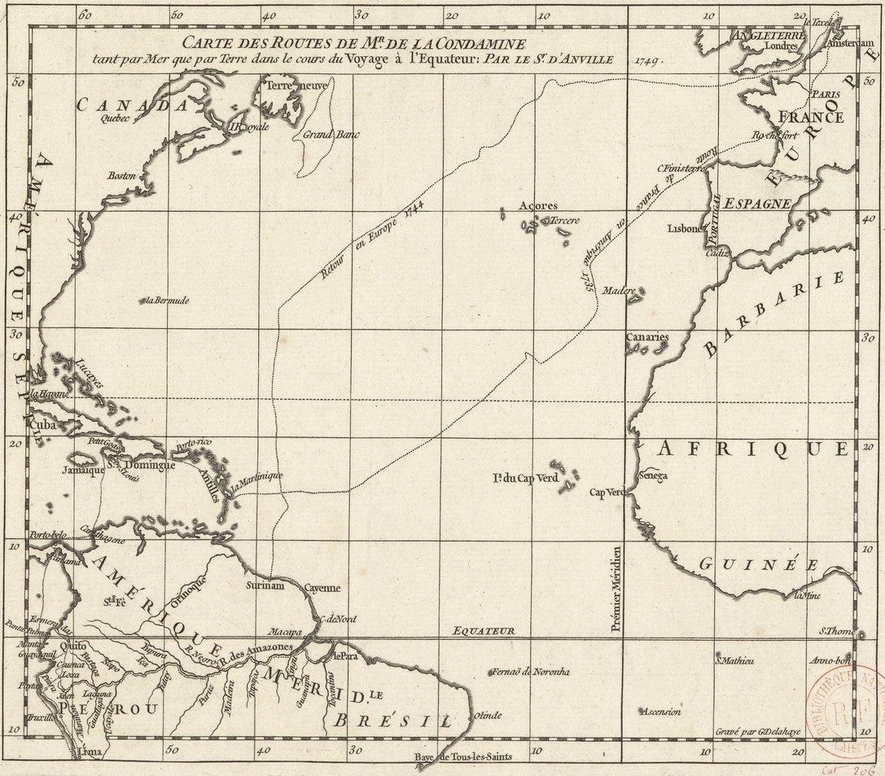
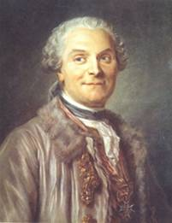
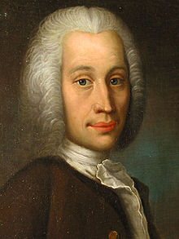
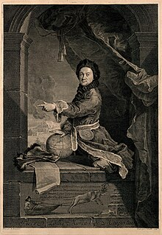
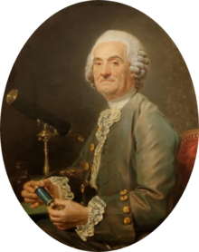
Shape of the Earth
1733-1744 : Missions in Lappland (Maupertuis, Celcius et al.) and Peru (La Condamine et al.) were organized to measured more extreme variations. The Paris one was also re-measured. Additionnal mission at the Cap of Good Hope (1751)
Lappland (66°20’N) : 57,438 toises per degree
Paris (48°N) : 57,183 toises per degree
Peru (~1°30’S) : 56,749 toises per degree
Good Hope (33°18’S) : 57,037 toises per degree
A degree is SHORTER closer to the equator!

Slide 15
Cassini and La Hire
Egg or Peach?
Maupertuis and La Condamine

Slide 16
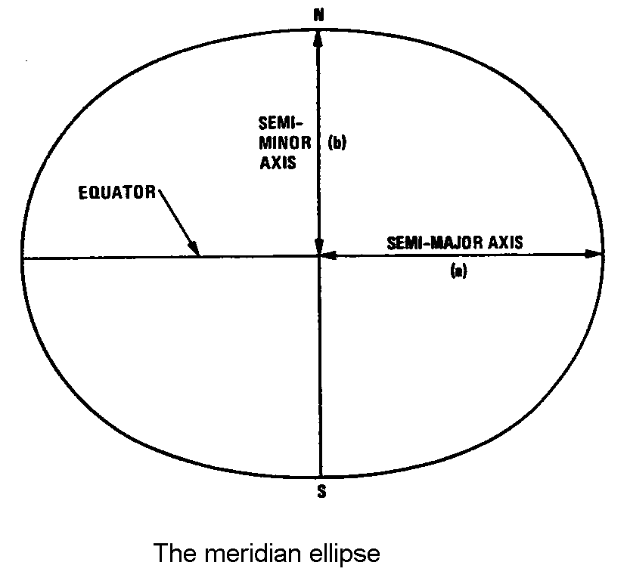
Reference system
Model of Earth
Ellipsoid: Ellipse rotated 360° around minor axis = Ellipsoid
Example (WGS84 / GRS80)
a = 6378137 m
f = 1/298.257223563
b = 6356752.314245 m
Equatorial circumference = 40075452.7 m
Polar circumference = 40007862.92 m
Diff = 67589.78 m

Slide 17
A digression…
What is a meter?
Original definition: (1795)
1/10 000 000 (ten-millinon part) of the meridian quadrant.
(Distance from pole to equator from Earths-size 1793 – redefined to meter prototype bar 1799 (adjusted 1889))
(Pol. circ. = 39939593,9m /4 = 9984898.475)
(GRS80 = 40007862.92m /4 = 10001965.73)
Today:
1 m = distance light travels in vacuum in 1/299 792 458 second

Slide 18
Datums
and
Reference systems

Slide 19
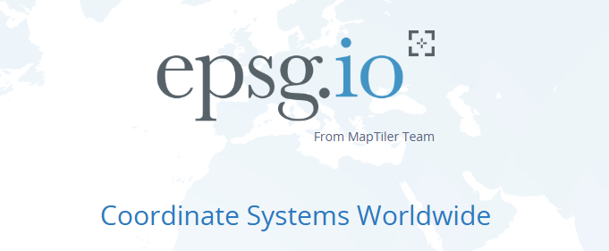
A note: all public coordinate systems have a unique EPSG code so a single number is a safe way to communicate the system you are using. Some global systems are called out by ESRI or other codes that are also well defined.
Common in Norway:
EPSG:25832 → ETRS89 / UTM zone 32N
EPSG:5972 → ETRS89 / UTM zone 32N + NN2000 height
In Europe:
EPSG:3035 → ETRS89-extended / LAEA Europe
EPSG:4937 → ETRS89 Latitude/Longitude/Ellipsoidal Heights
Global datum UTM zones:
EPSG:32632 → WGS 84 / UTM zone 32N
EPSG:32620 → WGS 84 / UTM zone 20N
Global projection systems:
EPSG:4326 → WGS 84 - World Geodetic System 1984, used in GPS, standard
ESRI:54016 → Gall Stereographic
ESRI:54052 → Goode Homolosine – Land
Other:
EPSG:3995 → WGS 84 / Arctic Polar Stereographic

Slide 20
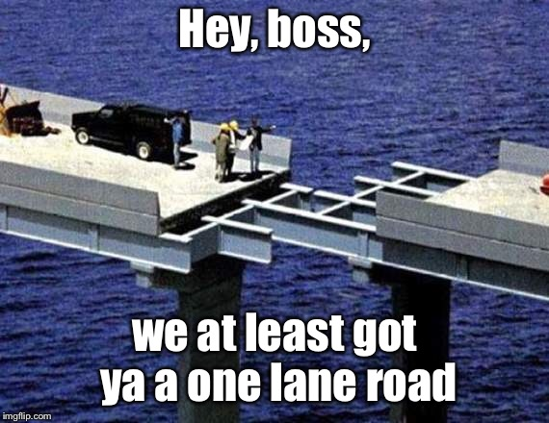
Reference Systems
They are required to relate our measurements together in a coherent «system»
We have several (many) different reference systems for plane coordinates and heights
To know which reference system we use is as important as the measurements
To make errors in the reference system can lead you astray…

Slide 21
HISTORY – and development of reference frames
Terrestrial reference frame: Fixed to the earth (rotating frame)
Inertial system fixed to stars (celestial)
Up to c. 1970/80 – Celestial reference frame (Ecliptic / Equator / Pole of rotation) => coordinates of stars (2D) (a large number of)
Today a set of very distant quasars (further, more immobile in space relative to Earth)
_____________________________________
Terrestrial frames were mostly national/regional/local
As satellite positioning (and other techniques) came into use – a global and far more accurate reference system was required.
ITRS/ITRF was born – but maintained a tie to the Greenwich meridian and more from the historical systems
ITRF(year) defines a set of coordinates and velocities for a number of sites at given epoch (time period / timestamp).

Slide 22
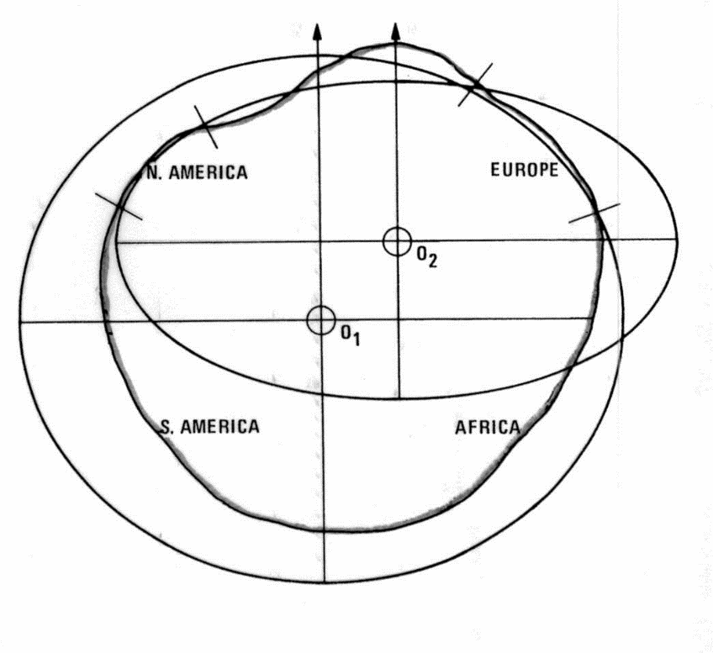
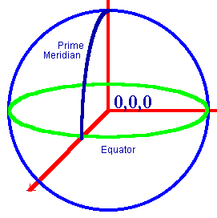
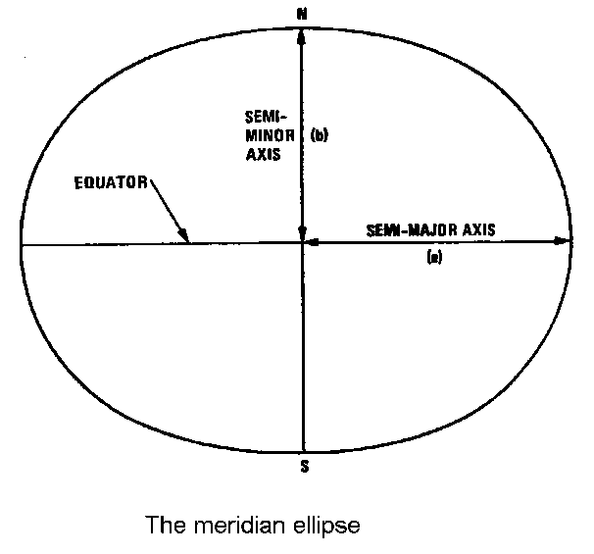
(Geodetic) Datum
Datum is a definition of size and shape of a model of the Earth (ellipsoid) and a tie of this reference model to the physical Earth body
Many different datums have been (and are) used
Coordinate systems are given in regards to datums, so the same coordintate sytem with a different datum will result in different coordinates for the same point
Today: Reference is the mass centre of the earth (0,0,0) + Rot.Axis+Prime meridian.

Slide 23
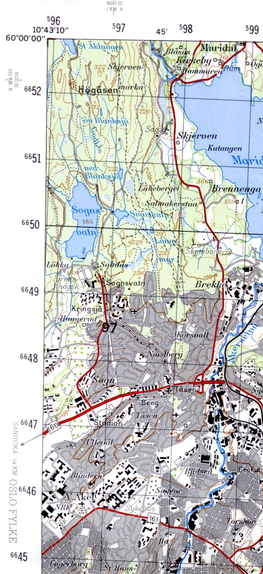
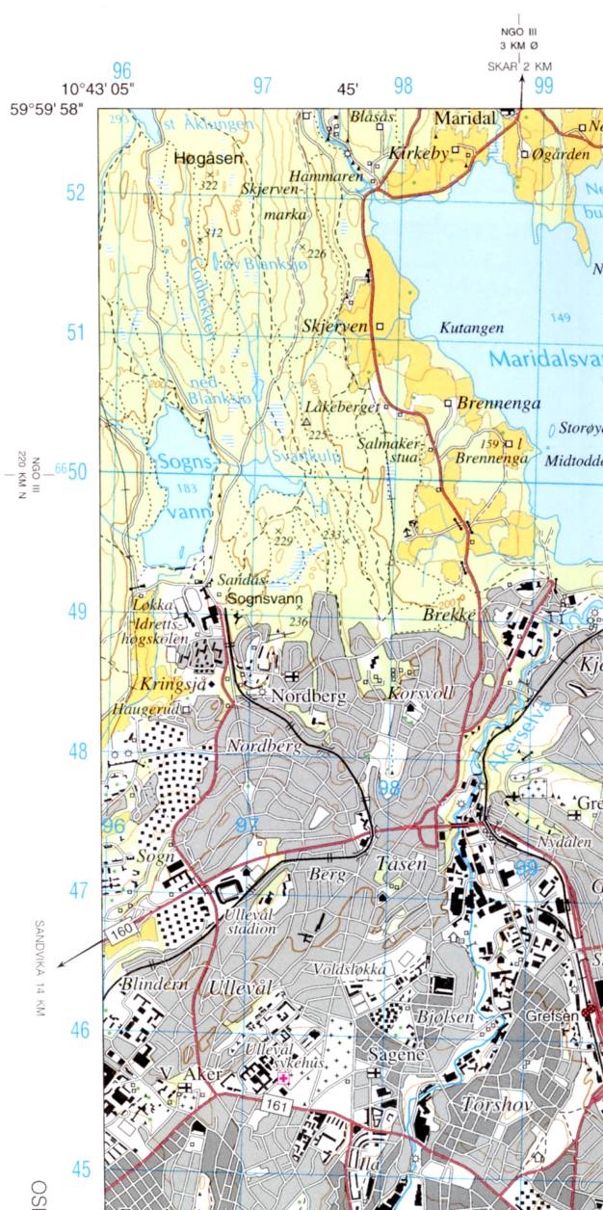
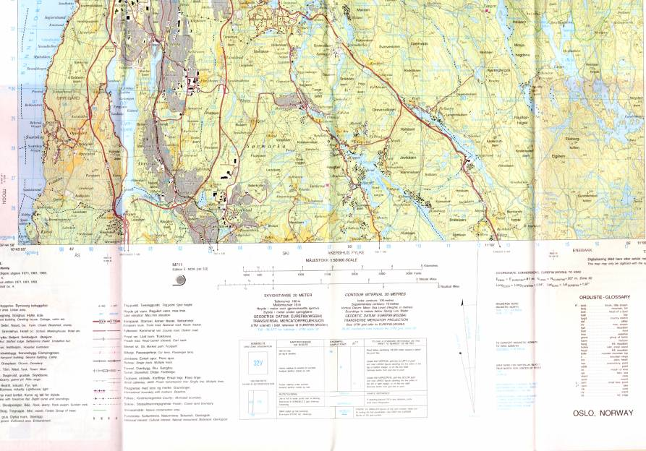
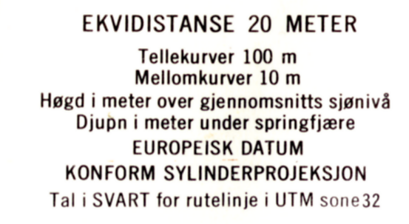
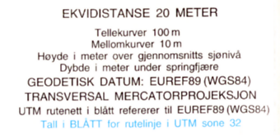
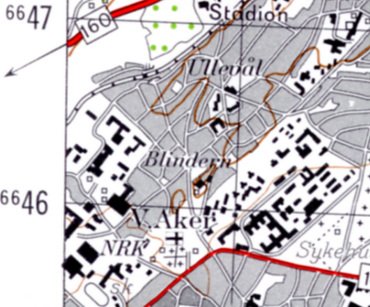
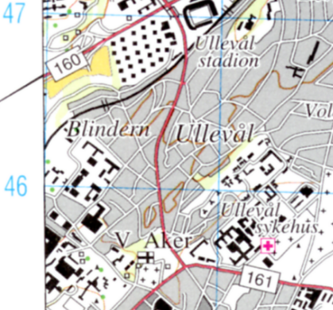
Kart over Oslo (N50)

Slide 24
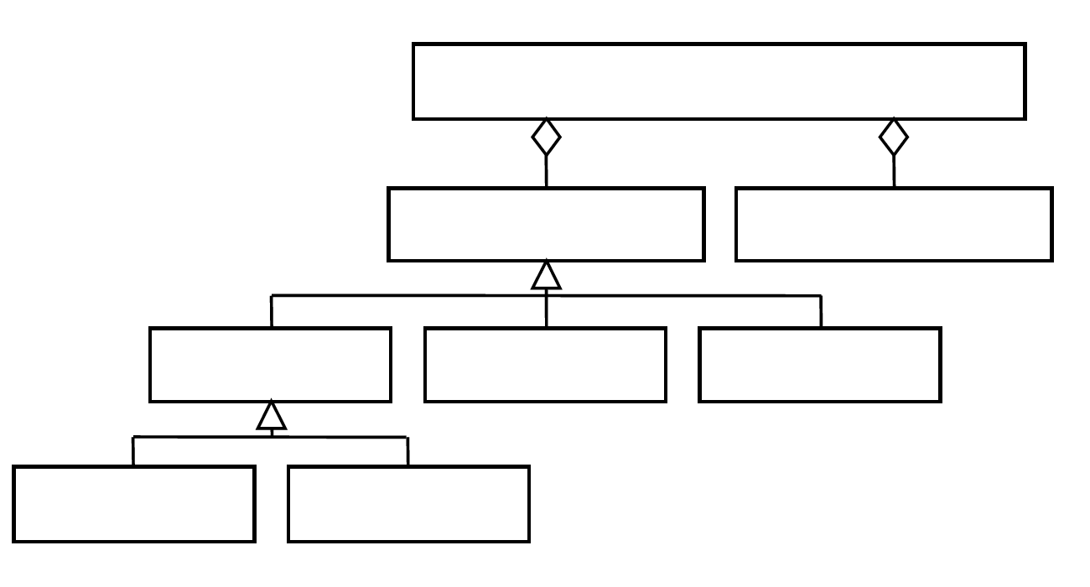
Reference system model: Coordinate based reference system (CRS)
N,E,H
coordinate based reference system
datum coordinate system
geodetic vertical «local»
Geocentric Topocentric
φ,λ, h_{ell}
*
Heights: 1D Coordinate
XYZ (ECEF)
Plane (2D) or 3D coordinates
*) Different «types» of Datums
Sk: Standard, Koordinatbasert referansesystem

Slide 25
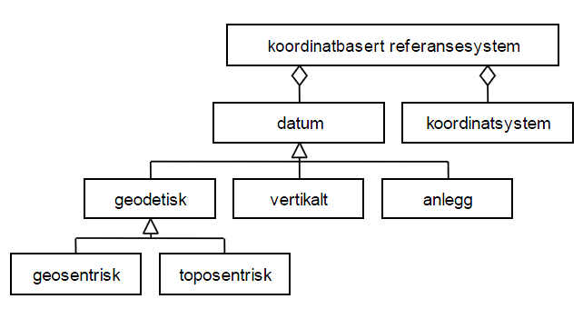
4.2 Datum
We separate between three main types of datum: (figur 1)
A geodetic datum, give the needed information (numbers) to give
unambiguous positions all over the earth.
We separate between geocentric and topocentric datum.
In a geodetic datum all heights are given relative to the used ellipsoid,
and the heights are called ellipsoid heights.
2) A vertical datum, give the needed information to give unambiguous gravity related heights.
3) An «anleggsdatum» («construction-datum»), give the needed information to give unambiguous positions within a limited area (e.g. at a construction site a reference point and a main axis of coordinates can be selected) .
4.2.1 Geodetic datum
A geodetic datum usually defines size and shape of an ellipsoid (earth model) used in mapping and surveying, together with positioning and orientation of the ellipsoid relative to the physical earth.
Prior to satellite based geodesy a traditional geodetic datum was tied to the earth surface in a fundamental point (topocentric datum).
A topocentric geodetic datum can be national and cover one nation, or regional and cover several nations. A topocentric geodetic datum requires more parameters defined than a geocentric datum which is tied to the mass center of the earth. A topocentric geodetic datum was tied to a fundamental point, usually an observatory, where deviation of the vertical and geoid height was given.
geocentric datum - tied to mass centre of Earth
topocentric datum - tied to a fundamental point (on surf.)
Sk: Standard, Koordinatbasert referansesystem

Slide 26
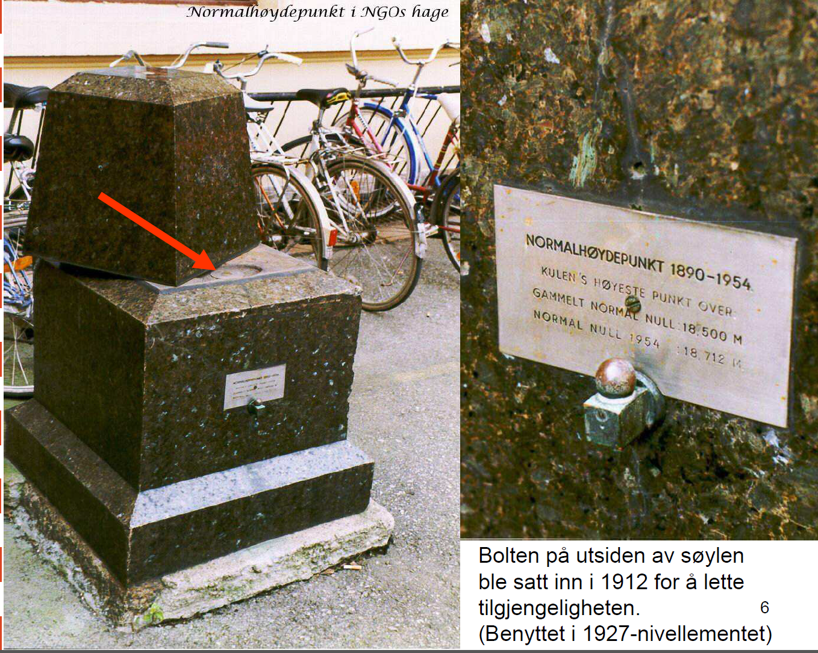
“Normal height reference benchmark” in the garden of NGO
Marker on outside of pillar was placed 1912 to make access easier. (Used in 1927-levellings)

Slide 27
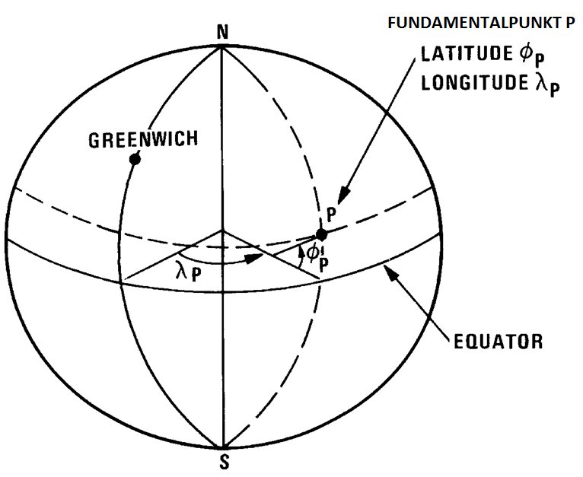
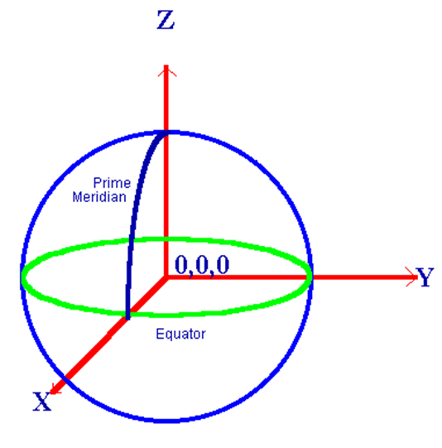
Geocentric
Topocentric

Slide 28
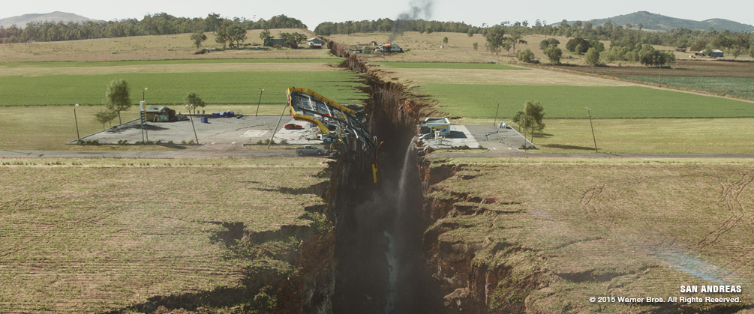
Small issue : the Earth’s surface isn’t stable/fixed

Slide 29
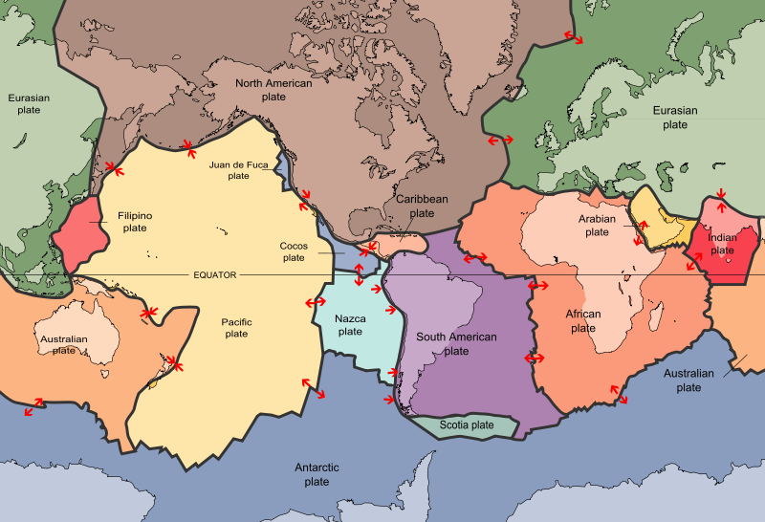
Figure 1.The Earth's surface is comprised of tectonic plates, which move independently of each other. The sense of motion between the plates is shown by the red arrows (Credit: USGS.)

Slide 30
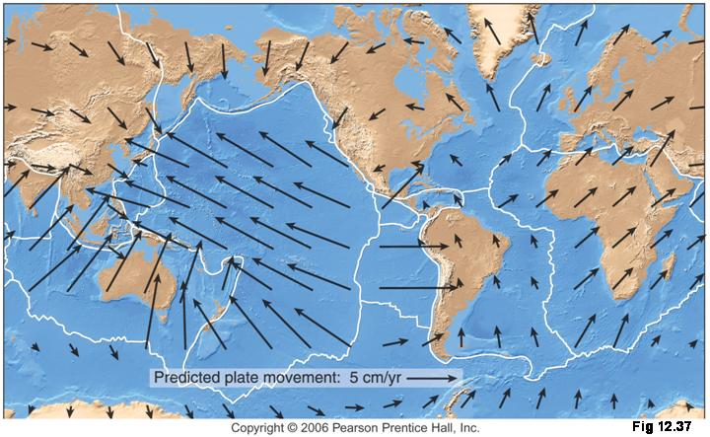
Figure 3.A map of the velocities predicted for a plate motion model. Plate boundaries are shown in white. (Credit: Pearson Prentice Hall.)

Slide 31
Terrestrial Reference System TRS => TRF (Frame)
Definitions
A Terrestrial Reference System (TRS) is a spatial reference system co-rotating with the Earth in its diurnal motion in space. In such a system, positions of points anchored on the Earth solid surface have coordinates which undergo only small variations with time, due to geophysical effects (tectonic or tidal deformations*). (*) Earth tide & OTL – Ocean-Tide-Loading
A Terrestrial Reference Frame (TRF) is a set of physical points with precisely determined coordinates in a specific coordinate system (cartesian, geographic, mapping...) attached to a Terrestrial Reference System. Such a TRF is said to be a realization of the TRS.
The Earth is constantly changing shape. To be understood in context, when the motion of the Earth's crust is observed, it must be referenced.
A Terrestrial Reference Frame provides a set of coordinates of some points located on the Earth's surface. It can be used to measure plate tectonics, regional subsidence or loading and/or used to represent the Earth when measuring its rotation in space. This rotation is measured with respect to a frame tied to stellar objects, called a celestial reference frame.

Slide 32
International Terrestrial Reference System
From Wikipedia, the free encyclopedia
The International Terrestrial Reference System (ITRS) describes procedures for creating reference frames suitable for use with measurements on or near the Earth's surface. This is done in much the same way that a physical standard might be described as a set of procedures for creating a realization of that standard. The ITRS defines a geocentric system of coordinates using the SI system of measurement.
An International Terrestrial Reference Frame (ITRF) is a realization of the ITRS. New ITRF solutions are produced every few years, using the latest mathematical and surveying techniques to attempt to realize the ITRS as precisely as possible. Due to experimental error, any given ITRF will differ very slightly from any other realization of the ITRF. Also, the difference between the latest WGS84 and the latest ITRF is only a few centimeters.^{[1]}
WGS84 was last aligned with ITRF2014, but it also gets updated in the background.
Practical navigation systems are in general referenced to a specific ITRFyy solution, or to their own coordinate systems which are then referenced to an ITRF solution.
GPS: WGS84 (World Geodetic System 1984) (Note SYSTEM, not a realization of it)
GLONASS Parametry Zemli 1990 (Parameters of the Earth 1990) (PZ-90) reference frame
Galileo Terrestrial Reference Frame (GTRF) ~ siste ITRF (<3cm avvik)
BeiDou Coordinate System (BDC) - China Terrestrial Reference Frame (CGCS) 2000 referred to ITRF97 with the epoch of 2000.0

Slide 33
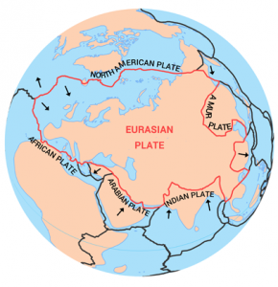
Europe is on it’s own plate (with a lot of Asia), so we can maybe create a system that is fixed in time for Europe?

Slide 34
EUREF89 (ETRS89)
To realize (implement) a geocentric datum the position of selected points (reference frame) on the earth surface are computed at a given time (epoch). Because of tectonic movements these selected points will move with time. Such selected points are the base for different international terrestrial reference frames (ITRF), and denoted with the actual year with two or four digits (e.g. ITRF97, ITRF2000). The year refers to the Gregorian calendar.
The European Terrestrial Reference System (ETRS), which the European states decided to use in 1990, follows the European tectonic plate and is called ETRS89, since it refers to the time (EPOCH) 1989.0. As long as this plate moves as a homogenous plate, the coordinates referring to ETRS89 will be unchanged.
EUREF89 is the name of the geodetic datum used in Norway for computations of the coordinates of points in «Stamnettet», and relates to ETRS89. EUREF89 is based on the international reference frame ITRF93 and rolled back to year 1989 corresponding to the guidelines for ETRS89.
Adjustment of the 113 points in «Stamnettet» called 3D-points, are a realization of EUREF89 as a geocentric geodetic datum.
Older standards, based on adjustments of the primary order networks, the European Datum 1950 (ED50) and NGO1948, were realizations of topocentric geodetic datums.
In these three datums respectively the GRS80-ellipsoid, the International Ellipsoid 1924, and the modified Bessel-ellipsoid are used.
Sk: Standard, Koordinatbasert referansesystem

Slide 35
EUREF89 (ETRS89)
The former used datums:
- NGO1948 – Bessel ellipsoid and
- European Datum 1950 – International ellipsoid 1924,
are both topocentric datums, realized by fundamental points, and with primary order trigonometric networks.
Plate tectonics continuously change the position of points.
Norway's annual change is c. 2cm in NE direction
Over more than 30 years this approaches 1m change.
Introduces problems with the most precise methods for satellite surveying.
Solution (?): The dynamic reference system (>3 dimensions in coordinates)

Slide 36
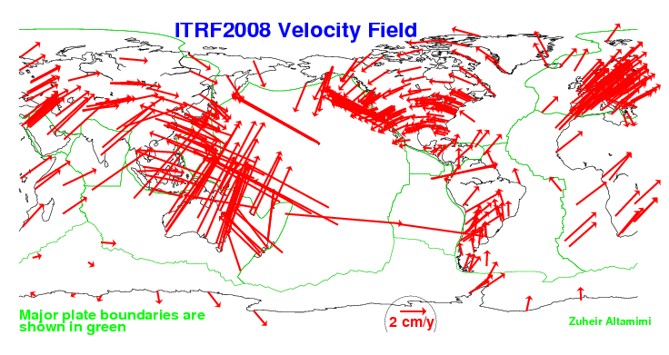
Figure 4.Measured motion of GPS sites. Plate boundaries are shown in green. (Credit: Zuheir Altamimi, ITRF.)

Slide 37
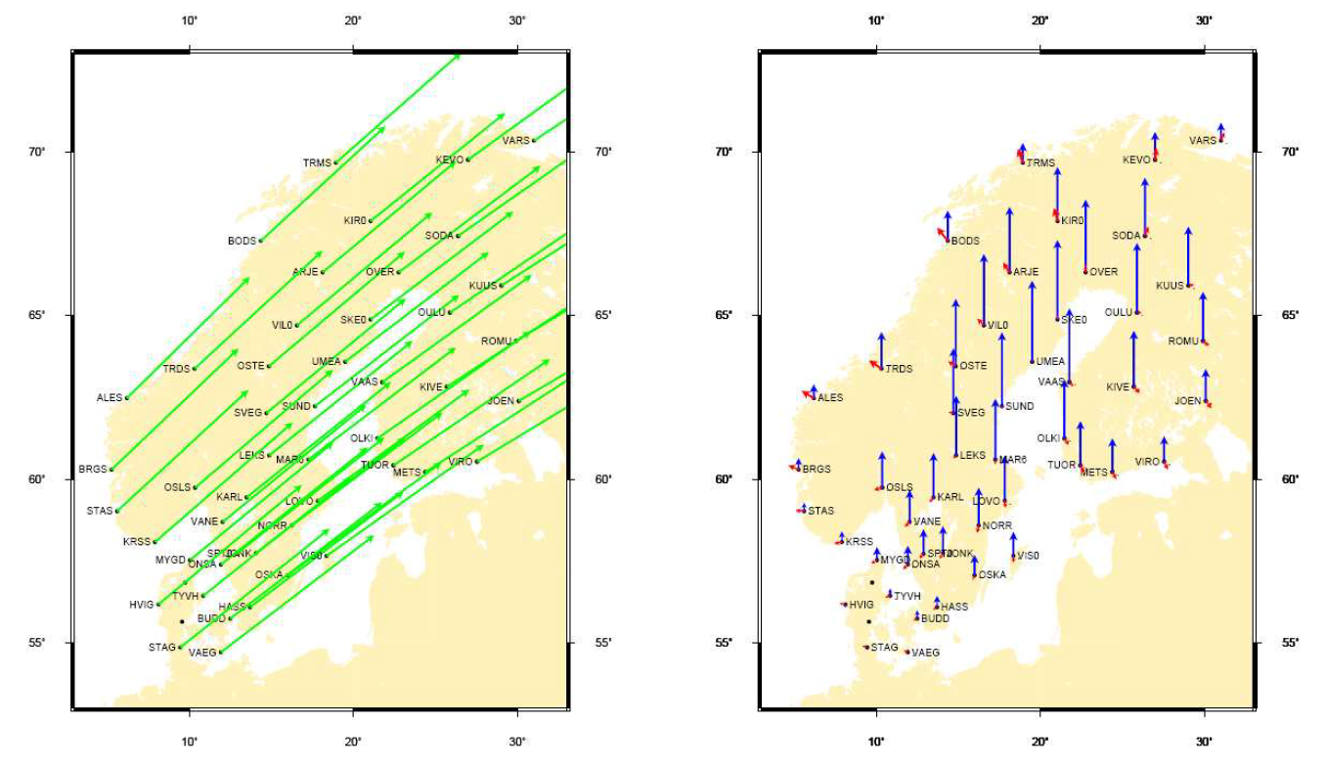
Even in Norway (Scandinavia) there are intra plate deformations (Nørbech et. Al.)
Fig 1. The left figure shows the (horizontal) plate tectonic motion in (mm/yr) according to the ITRF2000 Euler pole for Eurasia.
The right figure shows the intraplate deformations according to the NKG_RF03 velocity model which is relative to the stable Eurasia tectonic plate as defined by the ITRF2000 rotation pole for Eurasia. The red arrows show the horizontal velocities, and the blue arrows show the vertical velocity (with respect to the earth centre of mass) also in (mm/yr). Arrow scale is 1:1 (in the Nørbech et al. print).

Slide 38
How bad is it if you get it wrong?
Geologibygningen roof terrace :
EUREF89
Lat/Long/Ellh: 59.93761669 10.72101780 130.4937
ECEF : 3147274.3017 595879.4696 5497111.6806
ITRF2020
Lat/Long/Ellh: 59.93762318 10.72102814 130.5707
ECEF: 3147273.618 595879.928 5497112.109
Difference (ITRF2020-EUREF89):
Lat/Long/Ellh: 0.00000649 0.00001034 0.0770
ECEF : 0.6837 -0.4584 -0.4284000006
Distance: 0.9280m
→ Pretty bad

Slide 39
Coordinate systems:
from 3D points to a map

Slide 40



Slide 41

N,E,H

Slide 42
Coordinate systems
Earth centred XYZ – (Geocentric) 3D
Geodetic – latitude – longitude + ellipsoid height 3D
Geodetic – latitude – longitude 2D
Projected – map plane coords. 2D
Heights (in different systems) 1D
(can be the third dimension in geodetic and projected co-ord. Systems)

Slide 43

Different kinds of coordinate systems
Common for all: They are – more or less – erroneous, as the sphere (ellipsoid!) can not be made «flat» without distortions
Global → represent all/most of the planet
Regional/Local → only valid for a limited section
Equal-Area — correctly shows the size of a feature (aka Equivalent)
Conformal — correctly shows the shape of features
A map can not be both equal-area or conformal – it can only be one; or the other; or neither.
Equidistant — correctly shows the distance between two features
True Direction — correctly shows the direction between two features
COMPROMISE of the above (most projections)
Validity
Properties

Slide 44


Great-circle <-> Loxodrome (digression)
A great circle is the shortest way between two points on sphere’s surface.
On a map this is (normally) not the straight line between endpoints
Frankfurt - Los Angeles
What looks like a detour over Greenland, is a distance of 9300 km and more than 1000 km shorter than the "directe" violet line = 10600 km.

Slide 45

What is a Geodetic line?
The «great circle» is mostly impossible to calculate on an ellipsoid.
A plane containing the ellipsoid normal of A will (usually) not contain the normal of B. (exceptions)
The plane of A’s normal to ellipsoid intersecting B, creates a normal section.
The corresponding normal section from B will be different.
None of them can be the shortest line

Slide 46
Normal section and geodetic line
Figure 1.5 The lower heavy curve is the normal section from A to B, the upper heavy curve is the normal section from B to A, and the heavy curve in between is the geodesic between A and B.
It is the same in both directions.
We assume to be on the northern hemisphere.
The thin lines indicate short normal sections as defined by using a theodolite for setting out a straight line between A and B. If the number of setups tends to infinity and the distance between the setup points tends to zero the short normal sections will collapse to a single curve, viz. the geodesic

Slide 47

While super common, the global mercator projection is terrible at keeping areas, making equatorial countries look minuscule compared to higher latitude ones!
See https://thetruesize.com/

Slide 48


Slide 49



Basic Projection Techniques
An imaginary ‘piece of paper’ is placed in a certain way over the surface, and points are mapped to it
Azimuthal — the ‘piece of paper’ is flat, this is usually used over Polar areas
Conical — the ‘piece of paper’ is rolled into a cone, this is usually used in mid-latitude areas (approximately 20° – 60° North and South)
Cylindrical — the ‘piece of paper’ is rolled into a cylinder, this is usually used over Equatorial areas or for World Maps

Slide 50


Azimuthal projections
are distortions increasing away from the central point
have very small distortions near the centre point (the ’touch point of the paper‘)
compass direction is only correct from the centre point to another feature – not between other features
are not usually used near the Equator, because other projections better represent the features in this area.

Slide 51


R | 6378137 | m | Semi Major axis
Distance along circle | 1000000 | m | 1000km
Circumference | 40075016.69 | m | 2*pi*R
Percentage of circ | 2.4953%
Φ | 81.0168 | ° | 90-360*Percentage
D Gnomonic | 1008275.285 | m | R*tan(90-Φ)
D Polar | 1002053.525 | m | 2*R*tan((90-Φ)/2)
D Ortho | 995908.0788 | m | R*cos(Φ)

Slide 52

Coordinate system:
X = D * sin (λ)
Y = D * cos (λ)
Orthographic
Polar stereo
Gnomonic

Slide 53

Conical projections
are fan shaped when used to map large areas
have distortions increasing away from the central circular line (the ‘touch point of the paper’)
have very small distortions along the central circular line (the ‘touch point of the paper’)
shapes are shown correctly, but size is distorted
usually have lines of longitude fanning out from each other and have lines of latitude as open concentric circles.
Par LEIôPAR — Travail personnel, CC BY-SA 4.0, https://commons.wikimedia.org/w/index.php?curid=85958631

Slide 54


Cylindrical projections
are rectangular or oval shaped – but this projection technique is very variable in its shape
have lines of longitude and latitude at right-angles to each other
have distortions increasing away from the central circular line (the ‘touch point of the paper’)
have very small distortions along the central circular line (the ‘touch point of the paper’)
show shapes correctly, but size is distorted.
WGS 84 / World Mercator - EPSG 3395 - Google Satellite

Slide 55

Tangent vs Secant

Slide 56

Standard vs Oblique vs Transverse Mercator

Slide 57


Slide 58


Slide 59

Fun thing to try!
Install Indicatrix Mapper in QGIS

Slide 60




Plate carrée
UTM32N
UTM37N
Zones→locally valid systems?
Mercator

Slide 61


Map projection - UTM
Universal Transversal Mercator projection (UTM)
60 zones - each 6˚ wide (longitude), cover Earth (80S-82N)
Zone width on Equator c. 670 km.
Cylindar scaled by 0.9996 relative ellipsoid
Projection errors up to c. 1/1000
Coord.sys origin on Equator

Slide 62

https://commons.wikimedia.org/wiki/File:Universal_Transverse_Mercator_zones.svg

Slide 63


Slide 64


«UTM-map reference» (Standard reference (position)) MGRS
100km
Squares
in
coord.
sys.
32V MP 6364534080 (meter)
32V MP 63643408 (10-meter)
32V MP 636340 (100-meter)
32V MP 6334 (km)
((463645E 6834080 N) z32)

Slide 65

UTM in Norway
33X
35X
«Original» UTM-system in
Norway - extended zones.
Defined in NATO
(ca 1950)
Used until c. 1995 for ED50

Slide 66

UTM-system
in Norway, used today
”Customized” for digital
Map data

Slide 67

NTM zone 5 – 30 NTM-zones and UTM32 scale

Slide 68

Northing «N»

Slide 69
Southing «S»

Slide 70



CONVERGENCE of MERIDIAN
NORTH?
True North – meridian
Grid north (x-parall. in a point)
Azimut - A (direction relative true North)
Bearing – α (angle relative North for a line in map plane (usually denoted φ))
γ – meridian convergence = angle between meridian and grid-North in a point.
δ – bearing correction (map-proj.corr.) for geodetic line to straight line in map.
In the map plane with (x,y) coordinates, sides and angles from ellipsoid must be corrected to give straight lines between points
Alternatives to compute γ :
(φ, λ) to γ
or
(x,y) to γ
Geodetic line (geodesic)

Slide 71

Magnitude – bearing correction
Easting = 100km
Side 1km
Easting = 100km
Side 10km
Easting = 200km
Side 10km
Y = Easting
x= Northing
Bearing | Be. corr:
(degrees) | (grads)
0 | -0.00008
30 | -0.00007
60 | -0.00004
90 | 0.00000
120 | 0.00004
150 | 0.00007
180 | 0.00008
Bearing | Be. corr:
(degrees) | (grads)
0 | -0.00078
30 | -0.00069
60 | -0.00040
90 | 0.00000
120 | 0.00040
150 | 0.00069
180 | 0.00078
Bearing | Be. corr:
(degrees) | (grads)
0 | -0.00157
30 | -0.00137
60 | -0.00080
90 | 0.00000
120 | 0.00080
150 | 0.00137
180 | 0.00157
1milligrad = 0.001^{g} ~ arc = 1,6cm
on 1 km distance
(1.2mm)
(12cm)
(25cm)
Cental meridian 9° |  | Mer. conv | UTM32
Lat. | Long | (grads) | N | E
60N | 9E | 0 | 6651566 | 500000
 | 10E | 0.9625 | 6651988 | 555779
 | 11E | 1.9265 | 6653252 | 611549
 | 12E | 2.8934 | 6655361 | 667303
70N | 9E | 0 | 7766080 | 500000
 | 10E | 1.0442 | 7766393 | 538171
 | 11E | 2.0892 | 7767332 | 576335
 | 12E | 3.1357 | 7768897 | 614480
 | 13E | 4.1844 | 7771088 | 652598
Y < 30000 (NTM) – one third of the values (per km),
Negligible?
Magnitudes – meridian convergence

Slide 72

MAIN PROBLEM in UTM projection:
SCALE ERROR! (variation)
Projection – scale error:
-400 ppm
0 ppm
1000 ppm

Slide 73


Projection – scale error:
-400 ppm
0 ppm
1000 ppm
MAIN PROBLEM in UTM projection:
SCALE ERROR! (variation)

Slide 74


Magnitude – distance correction
Side 1000 m
Y = Easting
Easting (km)= | (S=1000m) dS=
0 | 0
10 | 0.001
50 | 0.031
90 | 0.100
100 | 0.123
150 | 0.277
180 | 0.398
250 | 0.770
330 | 1.340
Scale= dS = 1/6R²(y₁²+y₁y₂+y₂²)
«NGO1948» projection – max. Easting value 90km – max projection error 10 cm/km => scale error 1/10000
180 km is c. value for distance to intersection circle (secant) in UTM-projection (0,9996)
330 km is c. value for max distance to central meridian for UTM-projection (3° at equator)
In UTM the actual scale is 0.9996 + dS
Varies from 0.9996 to 1.00094 – CM to 3° (E/W) at equator

Slide 75

Distance correction:
=> S_{map plane} = S_{ellipsoid} + dS
Give the length in map plane relative to length on ellipsoid.
Y = Easting
Map plane
Ellipsoid

Slide 76

Tangent – scale = 1,00000
Map plane
10km
50km
Ellipsoid
100km
Distance correction => map proj. scale error:
Y = Easting
Easting= 10km – Scale correction per km ~ 0,0012m (Scale =1.0000012)
Easting = 50km – Scale correction per km ~ 0,0307m (Scale = 1.0000307)
Easting =100km – Scale correction per km ~ 0,1225m (Scale = 1.0001228)
Easting =180km – Scale correction per km ~ 0,3980m (Scale = 1.0003980)
Easting =330km – Scale correction per km ~ 1,3377m (Scale = 1.0013377)
Area: 30x30m
900,22m²
902,41m²

Slide 77


UTM – projection: Secant – scale = 0,9996 for central meridian
CM
S_{sf}
10km
Map plane
S
50km
Ellipsoid
200km
Distance correction – map proj. scale error:
where E’ = (E – 500000)/0,9996
Area: 30x30m
899,28m²
899,50m²
901,69m²
Y= 10km – Scale correction per km ~ 0,0012m (Scale =0.9996012)
Y= 50km – Scale correction per km ~ 0,0307m (Scale = 0.9996307)
Y=100km – Scale correction per km ~ 0,1228m (Scale = 0.9997228)
Y=180km – Scale correction per km ~ 0,3980m (Scale = 0.9999980)
Y=330km – Scale correction per km ~ 1,3377m (Scale = 1.0009377)
UTM33: Utsira E~-75000 Scale: 1.00367 A=906,61 Kirkenes: E~1112000 Scale: 1.00421 A=907,59

Slide 78

Scale in terrain <–> coordinate system
House at Blindern (10x20m)
(In terrain)
10 m
20 m
UTM32-system
PUNKT N E H
------------------------------------------------------------------------
1 6645700.0000 596150.0000 70.0000
2 6645700.0000 596169.9940
3 6645709.9970 596169.9940
4 6645709.9970 596150.0000

Slide 79


Map-projection – scale factor
Scale: 0,9996 - 1,0000 - 1,001
Has a millimeter per meter implications?
The surveyor fixes coordinates which give the «size» of the terrain with scale error.
Hardangerbrua:
Hardangerbrua, suspension bridge m.span 1310m. (Two twin towers in concrete w. h. 201,5m)
Bridge deck - 23 sections à 60 m length (built in China)
All engineering made from surveys with resulting coordinates:
i.e. all sizes / measures are given by coordinates.
Map projection corr. (theoretical max in Norway)
1310m * (1-0,9996) = 0,524 m
~ 8,7 mm per section
(In reality here only about half of this, but it will be a problem with too short – or too long elements)

Slide 80

EUREF89 NTM (Norsk Transversal Mercator) zone 5 - 30
Introduction
EUREF89 UTM (Universal Transversal Mercator-projection) is during first half of 2009 introduced as official datum and projection in all the municipalities in Norway. Introduction of EUREF89 has given us a modern, homogenous and precise geodetic basis which for most purposes can be considered error free.
…UTM-projection has a scale factor of 0.9996 at central meridian. This means that a distance measured in terrain, must be corrected with up to 400 ppm (parts per million) or 4 cm/100 meters, dependent on distance to central meridian, to find a distance in map plane.
For most new infrastructure projects, for example road constructions, the UTM-scale factor is not considered to be a problem. It ha no practical influence if a ”place-built” part of the road is 100.04m instead of 100.00m. The challenges are more specialized in setting out in construction projects with strict demands on tolerance as e.g. joining building parts.
https://www.kartverket.no/globalassets/til-lands/euref89_ntm_beskrivelse.pdf (in Norwegian)

Slide 81




Height systems
Next time

Slide 82
N,E,H

